Slide 1
PSYC003: Psychological Influences on Health & Behaviour
Diet & Weight Management
School of Psychology, University of Plymouth
Dr Rob Heirene
March 2023
Notes:
https://www.mentimeter.com/app/presentation/altr8mkxrkmrcrsuuk954u2jxs71uapy/v597cedctrfp/edit

Slide 2

About me
Name: Dr Rob Heirene
Office: A210 Portland Square
Email: Rob.Heirene@Plymouth.ac.uk

Slide 3
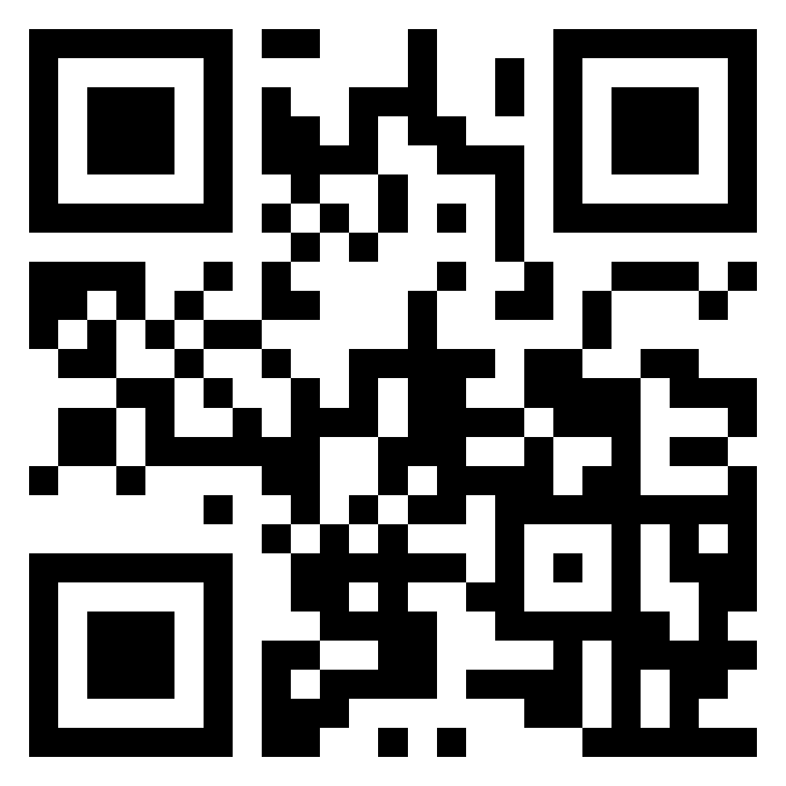
Recap quiz: Stress & Coping
Interactive task
Please go to the following site & enter this number:
13 59 11 8
2-question MCQ on stress & coping from last week’s lecture:
Login to Menti and add your answers
https://www.menti.com/

Slide 4

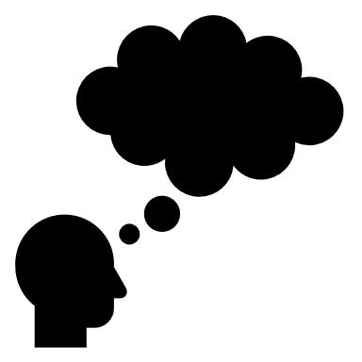


About today’s class
Block 1
Unhealthy diets
Obesity
Malnutrition
Diet & physical health
Diet & mental heath
Causes & correlates of poor dietary intake
Interactive task: What makes a healthy diet?
~10-minute break
Block 2
How can we promote healthy eating behaviour?
Key strategies
Behaviour change models
Common types of intervention
The need for regulatory change
Interactive task: Should we have a more extensive sugar tax in the UK?
~5-minute question
& discussion time

Slide 5
Block 1 Unhealthy diets

Slide 6

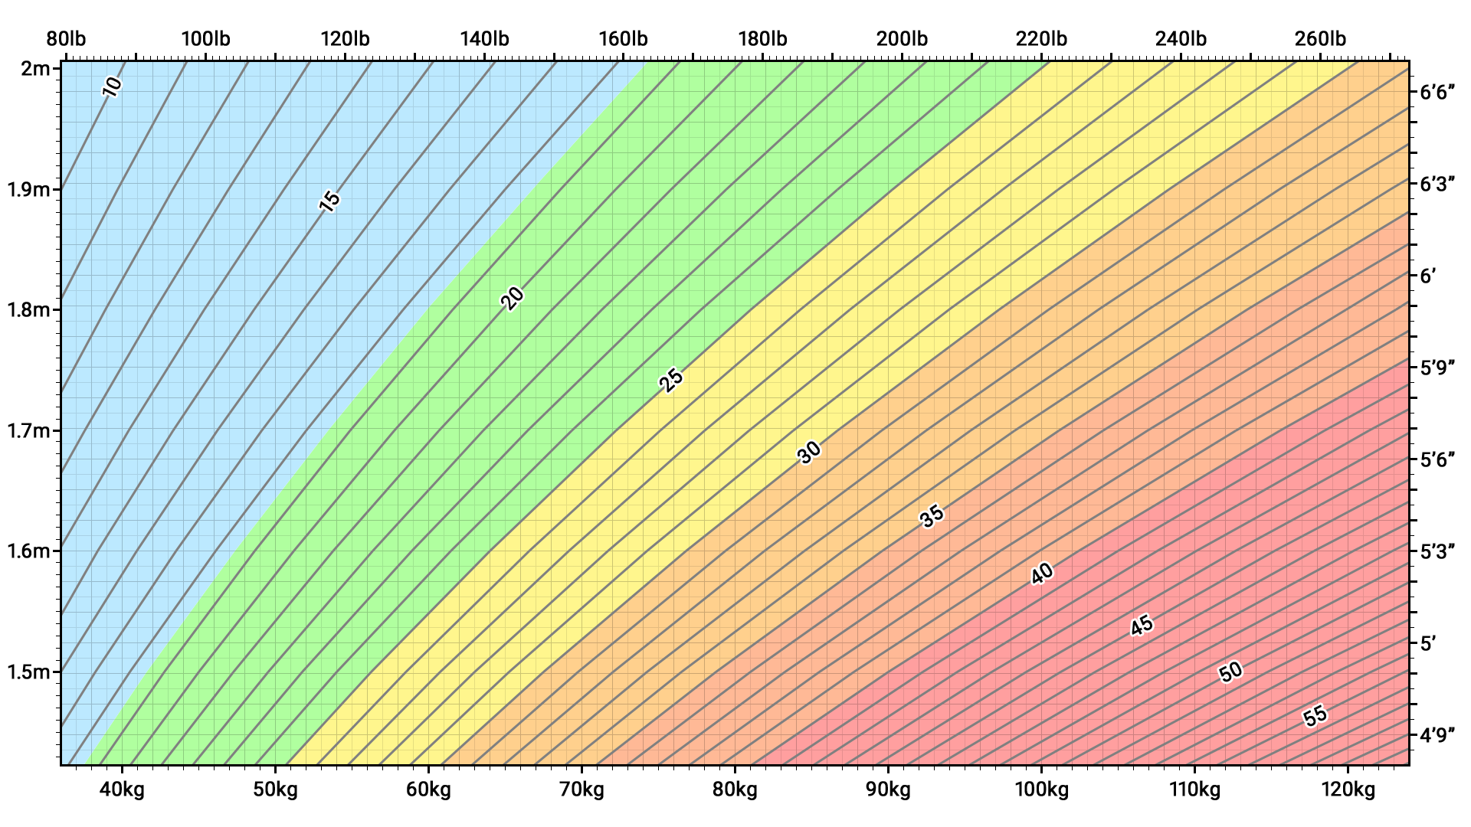
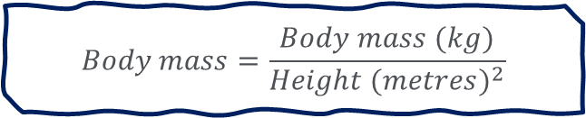
Unhealthy diets
Obesity
Weight categories and obesity are typically defined by Body Mass Index (BMI)
WHO (2022) ranges:
<18.5 = underweight
18.5–24.9 = normal weight (“healthy”)
25–29.9 = overweight
≥30 = obesity
Limitations?
Alternatives:
Visceral fat (compare with subcutaneous fat)
Waist-to-hip ratio
$$Body mass=\frac{Body mass (kg)}{{Height (metres)}^{2}}$$
Source: Wiki
Notes:
BMI is defined as the body mass divided by the square of the body height, and is expressed in units of kg/m², resulting from mass in kilograms and height in meters
One of the main limitations of BMIs it that it treats all body mass, including fat, muscles, organs, bone structure as equally risky for health
BMI may not be appropriate for assessment in (https://ourworldindata.org/obesity-definition):
Pregnant women
Athletes, or people with large amounts of muscle mass
Particular ethnicities – in particular, those of Asian origin. This is because those of Asian origin tend to store more visceral fat around the abdomen, as opposed to storing it subcutaneously, just under the skin. This means they are at higher risk of negative health outcomes at a lower BMI. While the WHO maintains consistent BMI thresholds internationally, it suggests that for those of Asian origin, elevated risk might be as low as a BMI of 22 kg/m² – significantly lower than the international threshold of 25 kg/m² for being overweight.³
We know that adipose tissue, particularly visceral fat is most strongly associated with poor health outcomes, as compared to subcutaneous fat (which sits just under the skin and is distributed across the body).
Women tend to have more subcutaneous fat and men more visceral fat, which is thought to be one of the reasons why women live longer than men.
However, requires abdominal imaging like CT scans – expensive, time consuming, impractical
WAIST TO HIP!!!!
Overall, BMI and practically useful guide nonetheless

Slide 7
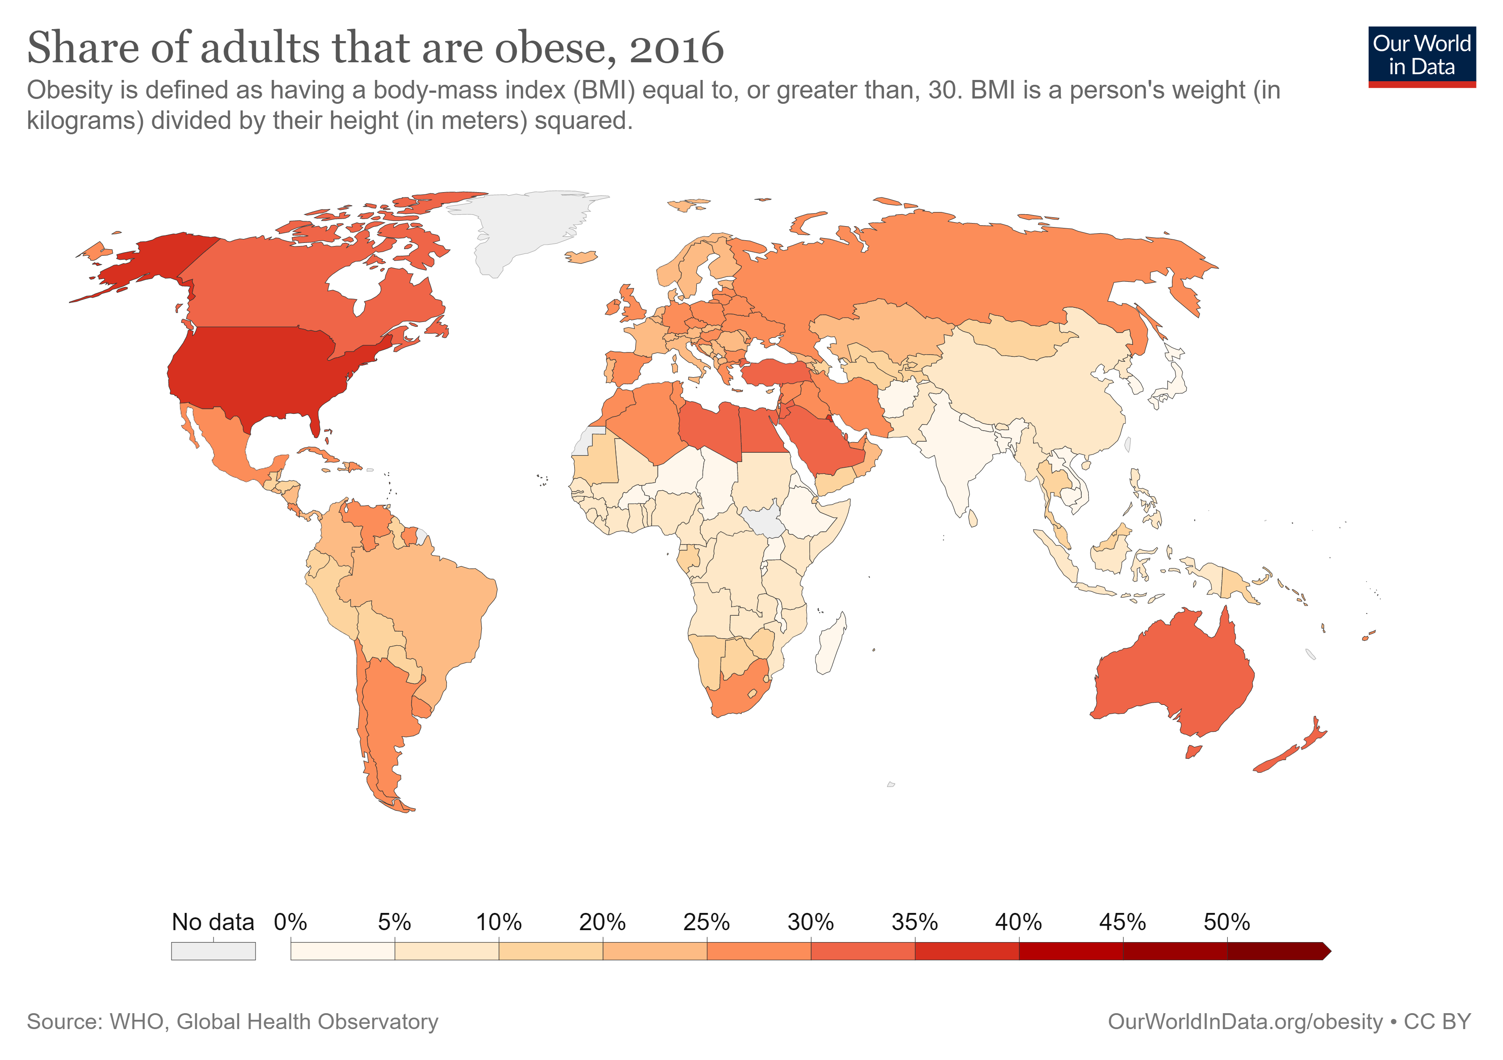
Unhealthy diets
Obesity
WHO (2022):
Worldwide obesity has nearly tripled since 1975.
39% of adults aged 18 years and over were overweight in 2016 (more than 1.9 billion)
13% were obese in 2016 (650 million)
Source: Our world data
Notes:
A concerning observation that has been made over the last 20+ years is that:
Obesity rates are very high and appear to be increasing
[READ SLIDE]
This refers to people with a BMI equal to or greater than 30

Slide 8
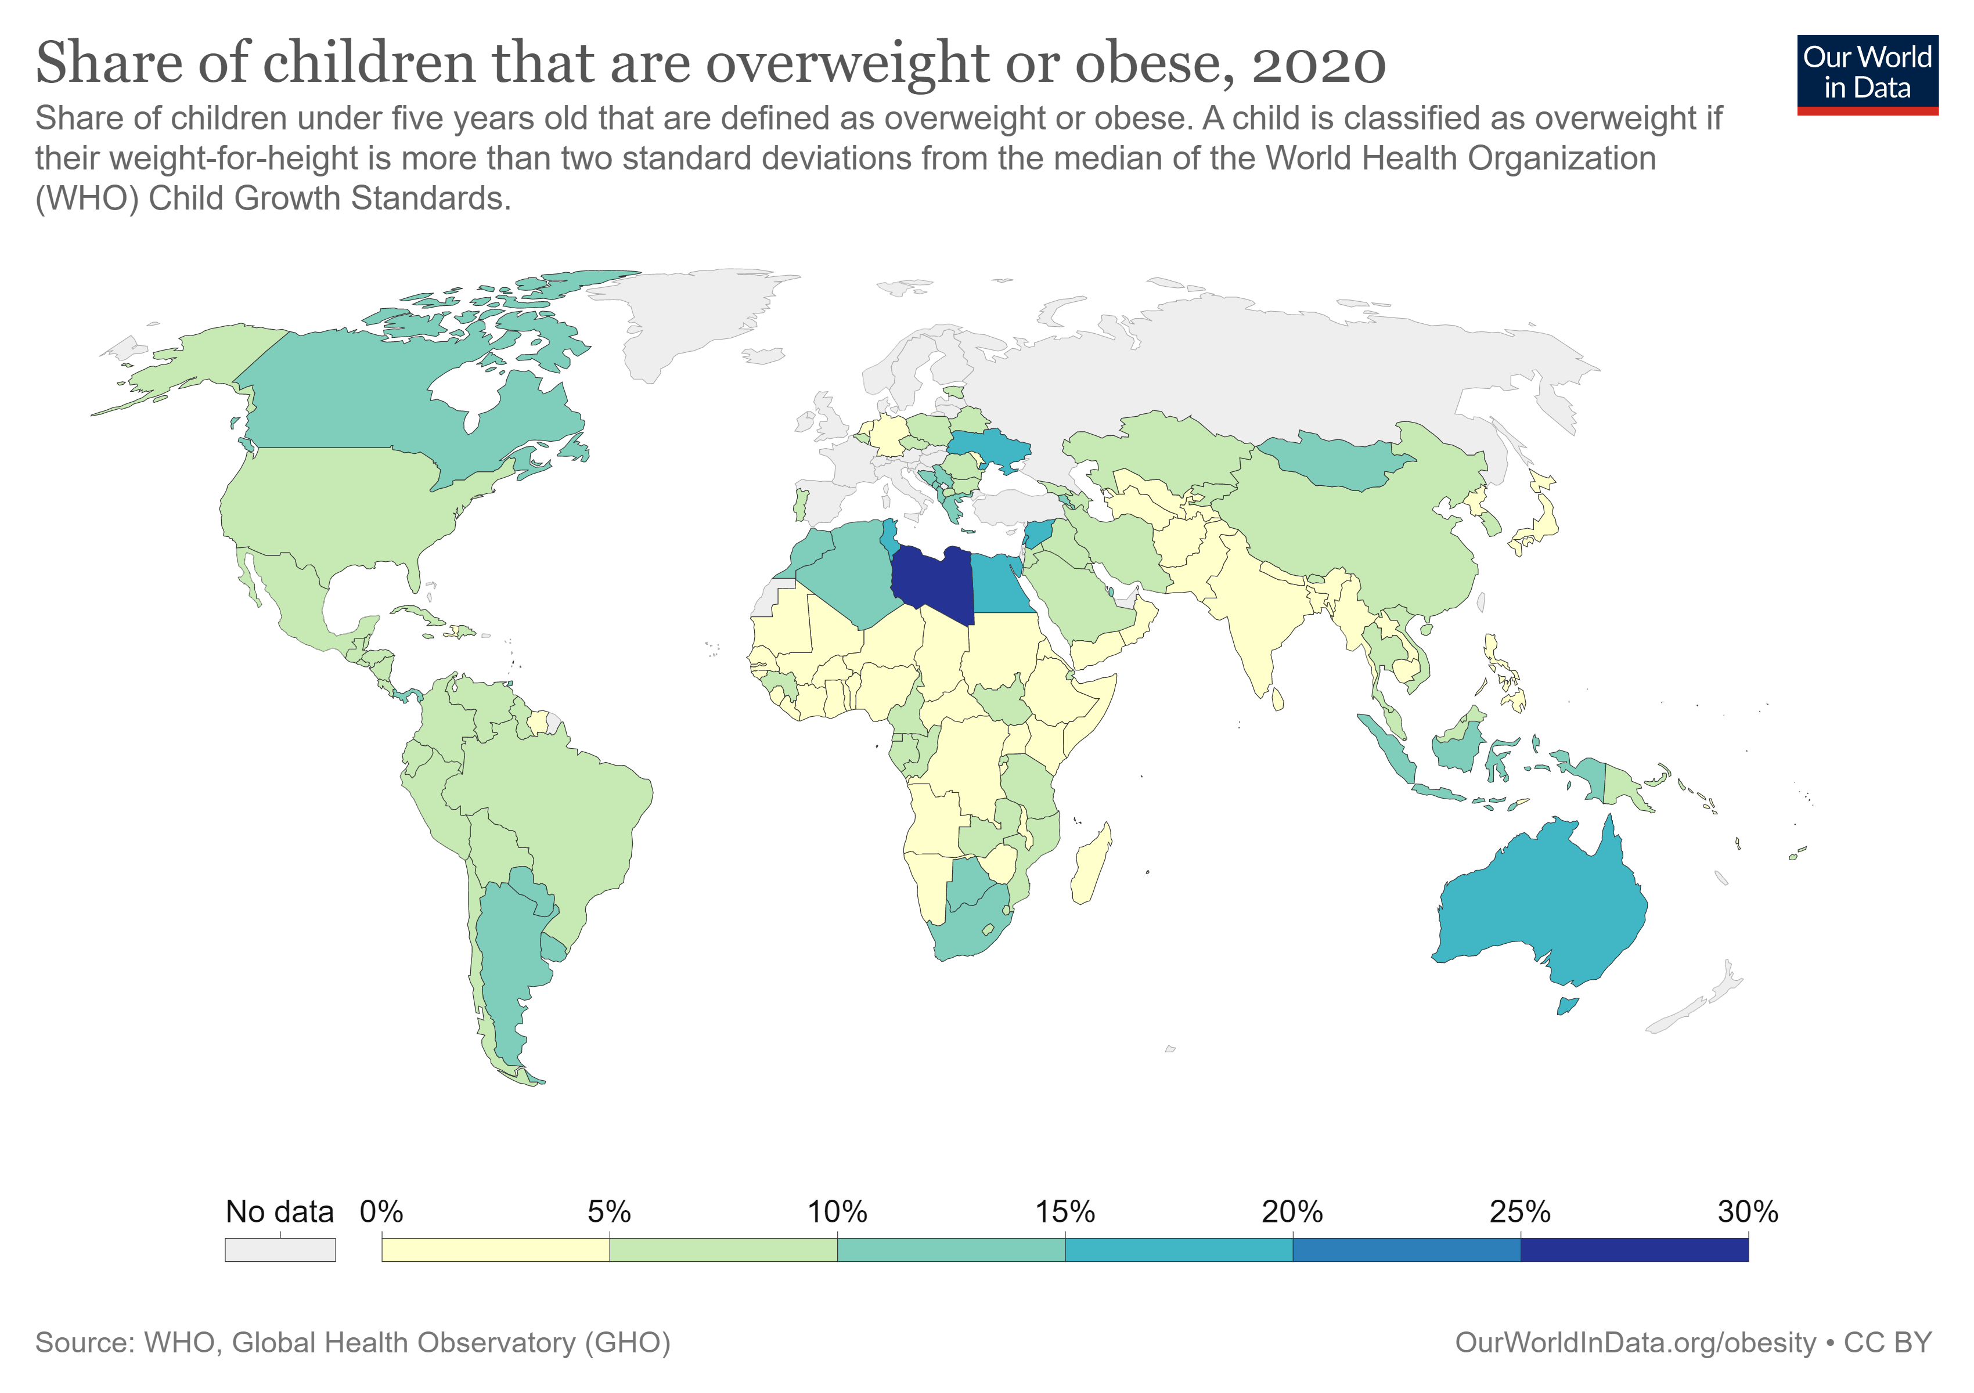
Unhealthy diets
Obesity
WHO (2022) & Abarca-Gómez et al. (2017):
39 million children under the age of 5 were overweight or obese in 2020.
Over 340 million children and adolescents aged 5-19 were overweight or obese in 2016.
Despite this, more children and adolescents are moderately to severely underweight than obese (increasingly concentrated in south Asia and central, east and west Africa; 2017)
Changed now?
Source: Our world data
Notes:
Obesity in children is a particular concern:
Image: For children under five years old, overweight and obesity is defined as the following:
Overweight: a child is defined as overweight if their weight-for-height is more than two standard deviations from the median of the World Health Organization (WHO) Child Growth Standards.
Obese: a child is defined as obese if their weight-for-height is more than three standard deviations from the median.
However, if post-2000 trends continue, child and adolescent obesity is expected to surpass moderate and severe underweight by 2022.

Slide 9
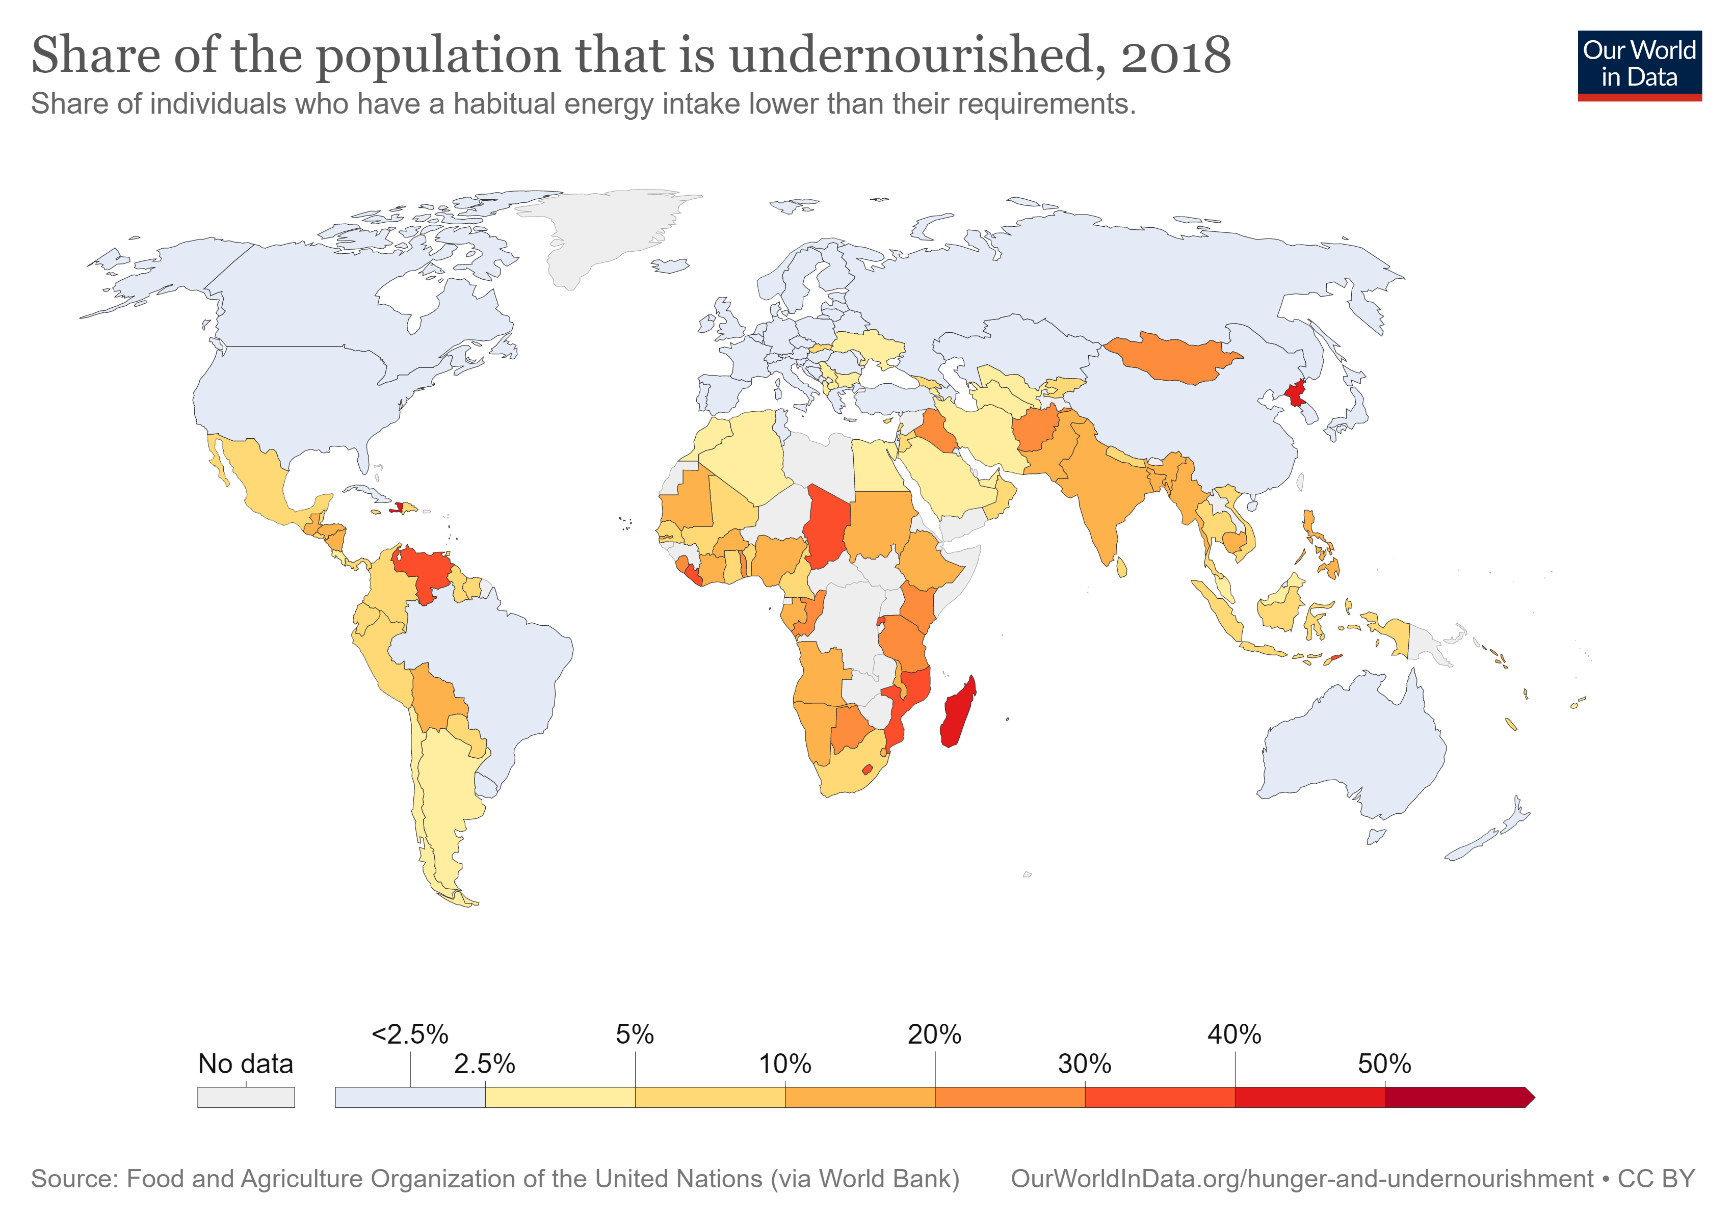
Unhealthy diets
Malnutrition
“lack of proper nutrition, caused by not having enough to eat, not eating enough of the right things, or being unable to use the food that one does eat” (Oxford Dictionary)
“Malnutrition, in all its forms, includes undernutrition (wasting, stunting, underweight), inadequate vitamins or minerals, overweight, obesity, and resulting diet-related noncommunicable diseases” (WHO, 2022).
Source: Our world data
Notes:
Malnutrition has been defined in two ways displayed here: [READ DEFINITIONS]
A lack of sufficient food is one of the leading causes of death in the world, although as mentioned on the previous slide most of this occurs in increasingly isolated regions, as we can see in the map

Slide 10
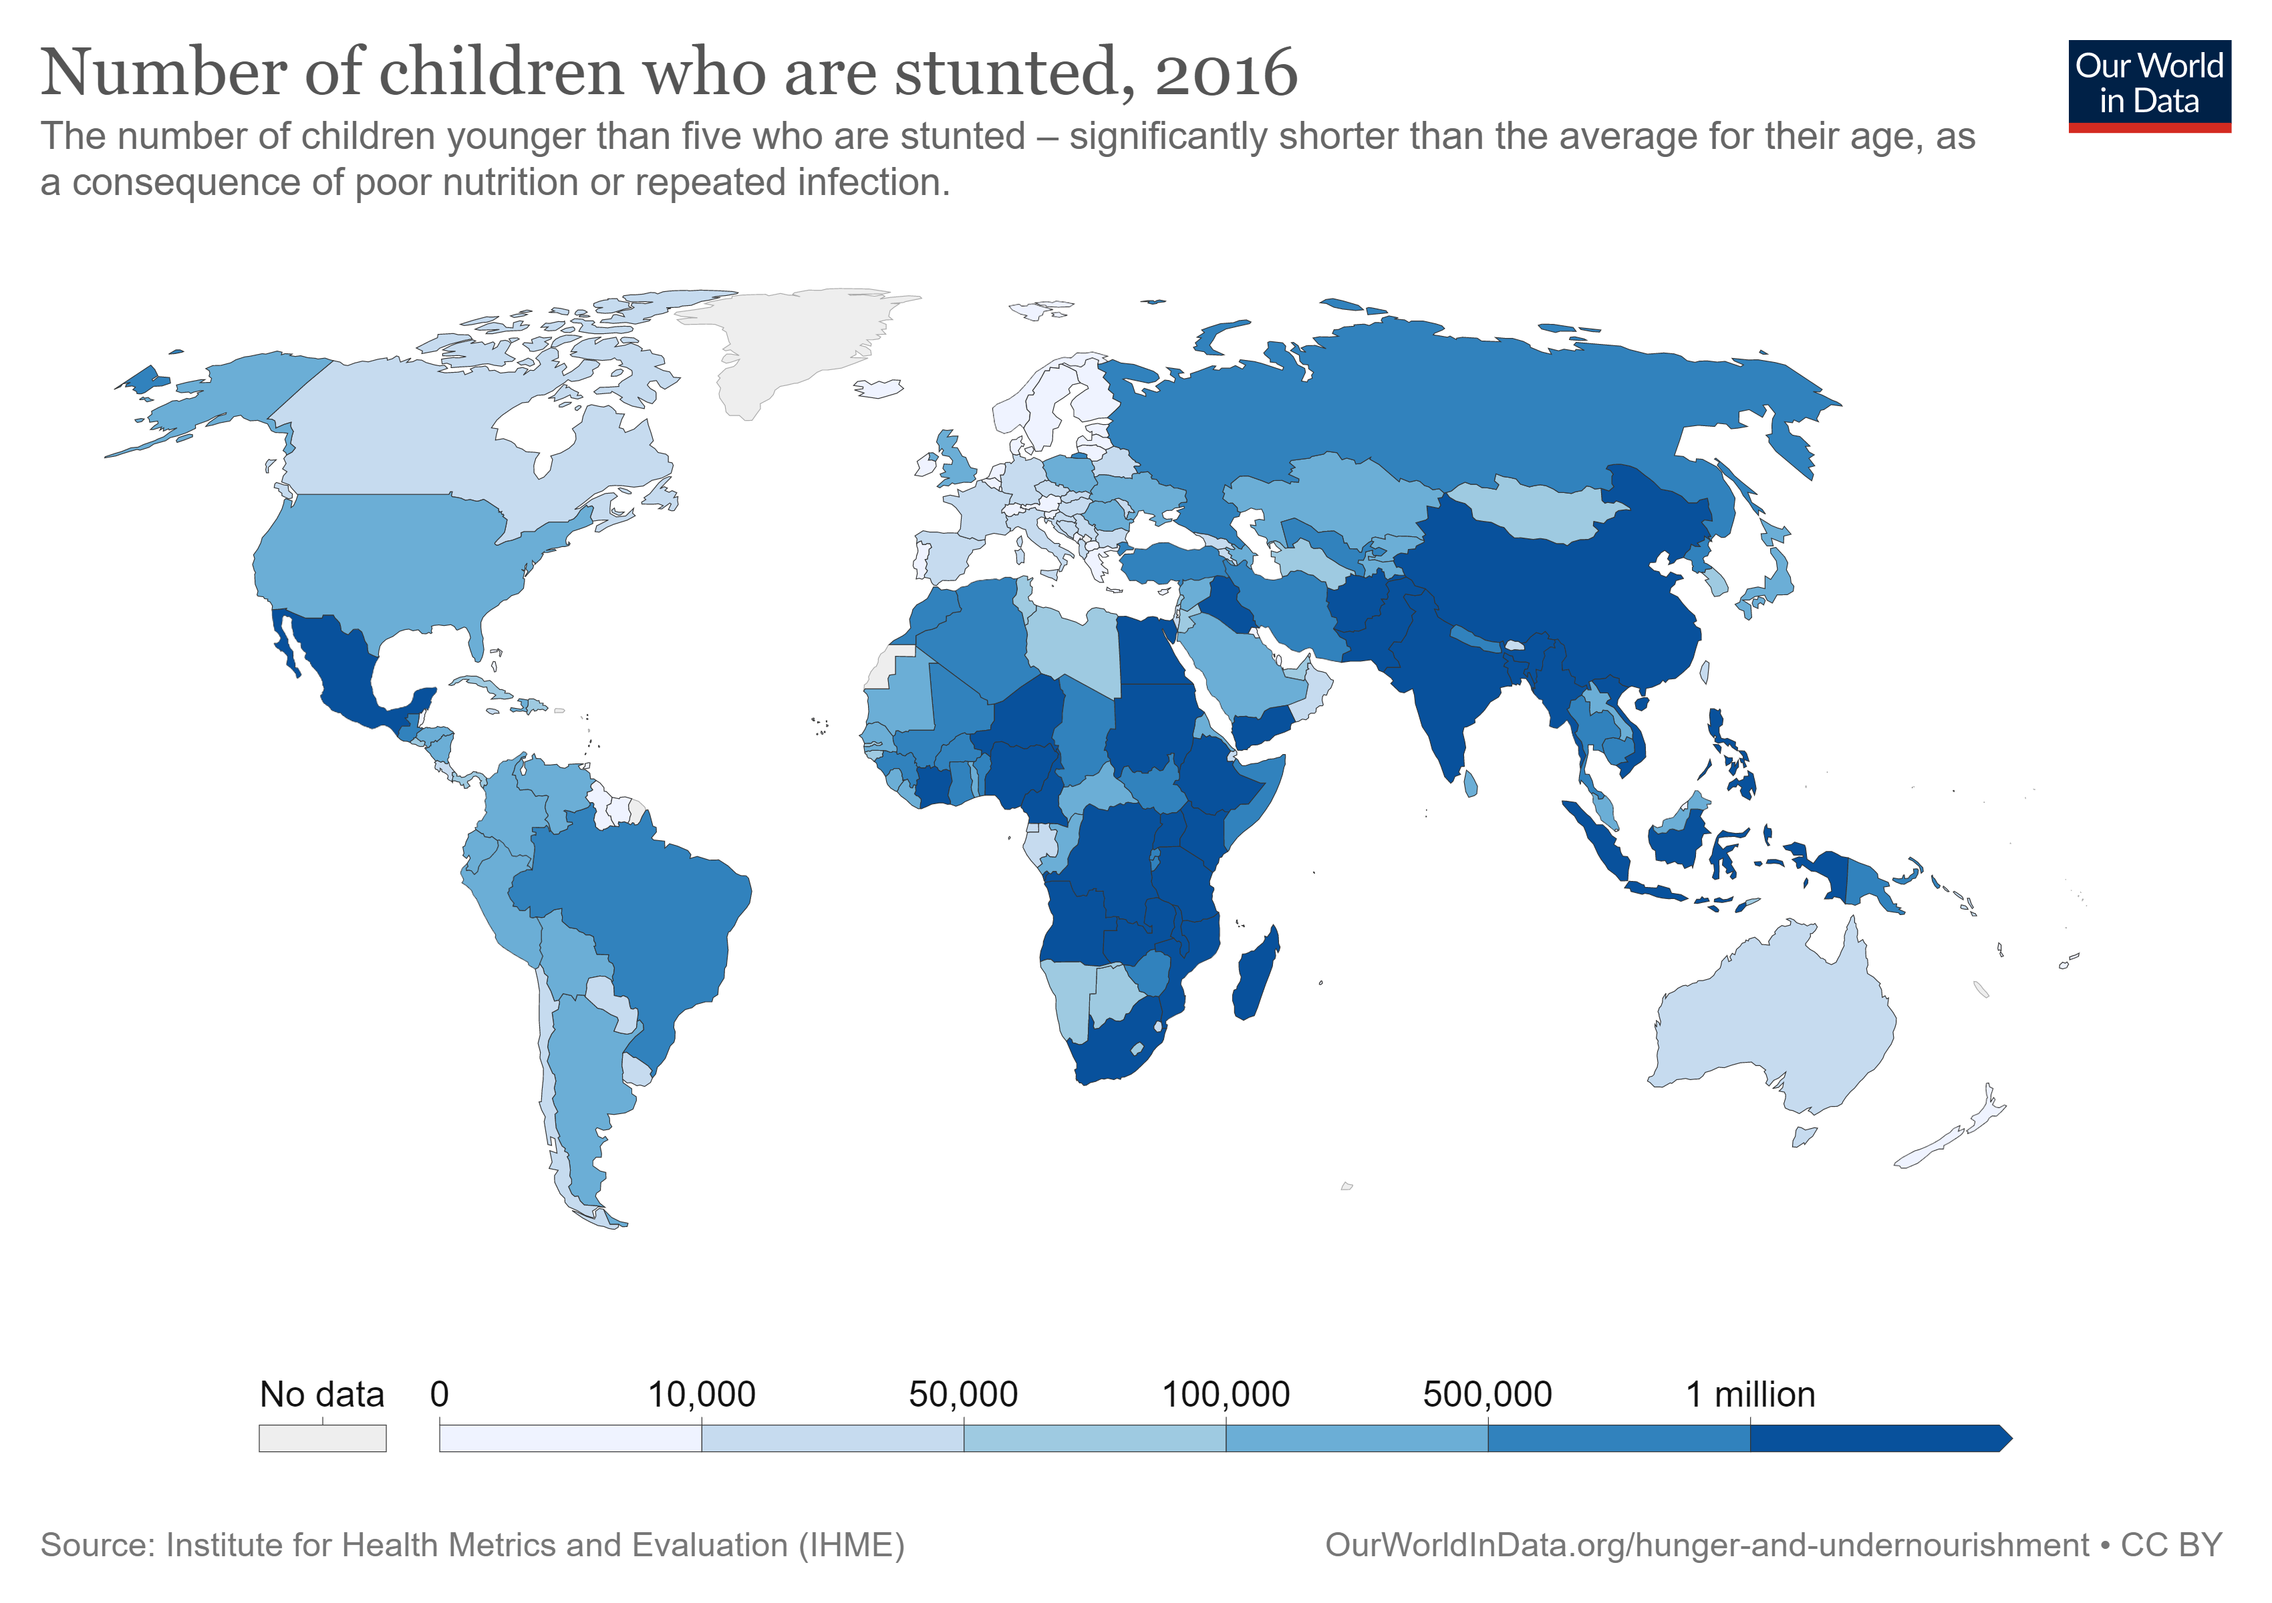
Unhealthy diets
Malnutrition
8.9% of the world are undernourished (663 million people) (Roser & Ritchie, 2019)
22% of children <5 are ‘stunted’ (Roser & Ritchie, 2019)
~42% of children have anemia (Roser & Ritchie (2017)
17.3% of people are deficient in zinc (Wessells & Brown, 2012)
Other common (but decreasing) deficiencies include those of iodine (Biban & Lichiardopol, 2017) and vitamin A (Stevens et al., 2015)
Source: Our world data
Notes:
In terms of overall prevalence, it’s estimated that , 8.9% of the world are undernourished (663 million people) (Roser & Ritchie, 2019)
And this is a common cause of several growth difficulties and deficiencies in key vitamins and minerals
22% of children younger than five are ‘stunted’ – they are significantly shorter than the average for their age, as a consequence of poor nutrition or repeated infection.
Anemia is a condition whereby an individual’s blood lacks enough red blood cells (RBCs) to carry oxygen efficiently around the body. Anemia can result from a lack of iron or vitamin B₁₂, although iron deficiency is the most common type.
Zinc is an essential nutrient for growth and recovery; deficiencies can therefore stunt growth; increase susceptibility to disease and infection; increase recovery time, or in some cases, impair recovery; reduce mental capacity; and increase the prevalence of maternal, neonatal and child complications – associated with stunting
Vitamin A deficiency is a risk factor for blindness and for mortality from measles and diarrhoea in children aged 6–59 months

Slide 11
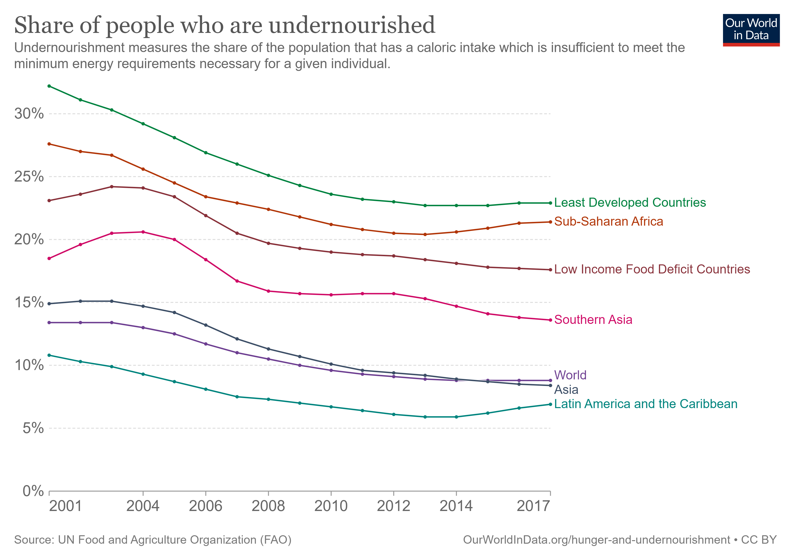
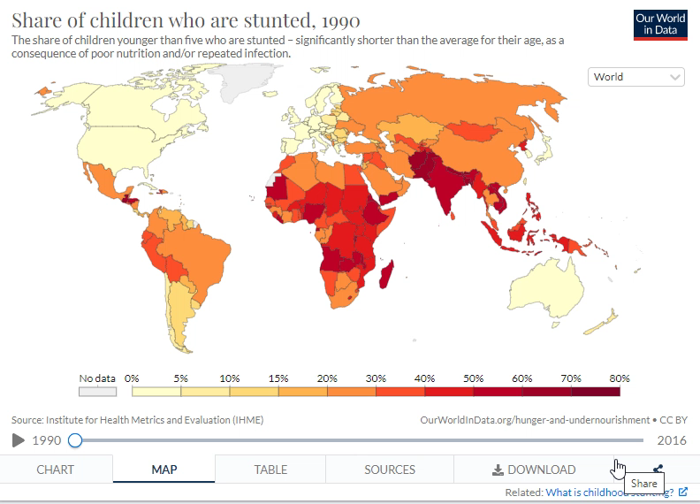
Unhealthy diets
Malnutrition
Source: Our world data
Source: Our world data
Notes:
Before we move on, that’ was all pretty depressing so let’s see some more positive-looking graphs!

Slide 12
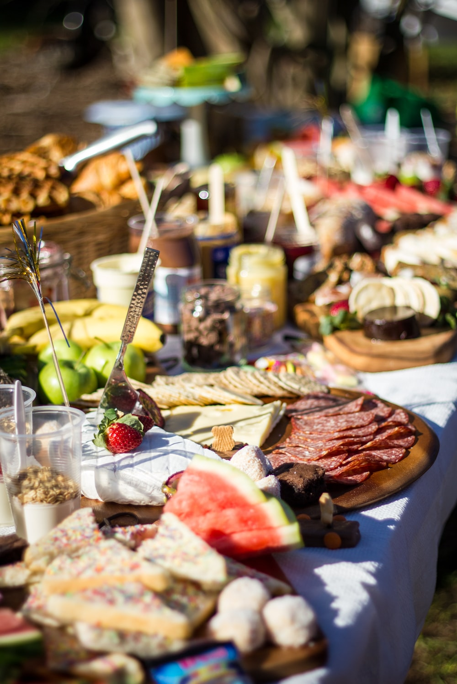
Unhealthy diets
Relevance to psychology
Why does this all matter to health psychology?
Dietary consumption is a (mostly) modifiable behaviour
Changes in diet can have a significant impact on health, positive or negative, depending on our choices
Makes diet a good target for health-focused intervention
Notes:
Okay why does all of this matter in relation to psychology? Well, dietary consumption is, in many areas of the world, a modifiable behaviour.
In most developed societies food is not short of supply and so we what we eat becomes a choice.
Unlike exposure to disease and pollution, we can easily modify out food choices
We can all choose the watermelon over the salami and crackers
And poor dietary choices are a huge source of disease burden for us, both via obesity and vitamin deficiencies,

Slide 13
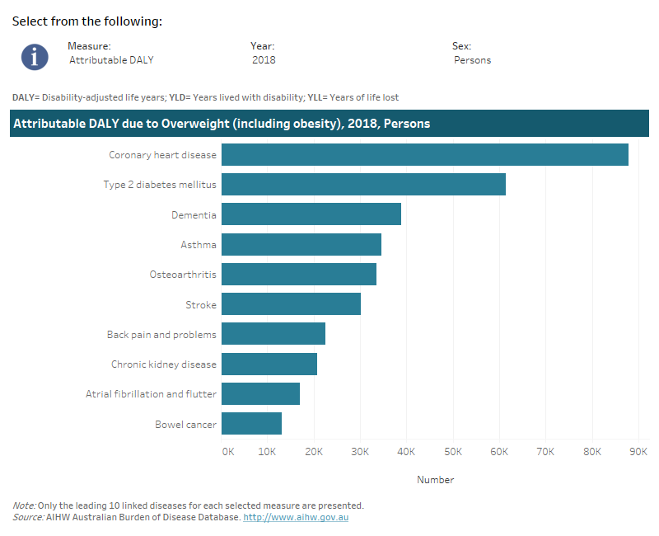
Unhealthy diets
Diet & physical health
Australia in 2018 (Australian Institute of Health and Welfare, 2021):
8.4% of total disease burden in Australia during 2018 attributable to being overweight (2nd only to tobacco use)
Being overweight contributed to 17 types of cancer, for cardiovascular diseases, three musculoskeletal conditions, type II diabetes, dementia, asthma, and kidney disease
Disease burden attributable to being overweight was two times greater in the lower socio-economic group compared to the highest
Source: AIHW
Notes:
Okay, let’s quickly look at how diet and weight affect physical health:
Burden of disease is a measure of the years of healthy life lost from living with, or dying from disease and injury.
The disease burden attributed to a selected risk factor is referred to as ‘attributable burden’ and is measured in terms of Disability Adjusted Life Years (or DALY).
It reflects the reduction in fatal burden (measured by years of life lost (YLL)) and (non-fatal burden measured by years lived with disability (YLD)) that would have occurred if exposure to the risk factor had been avoided or reduced to its lowest level.

Slide 14
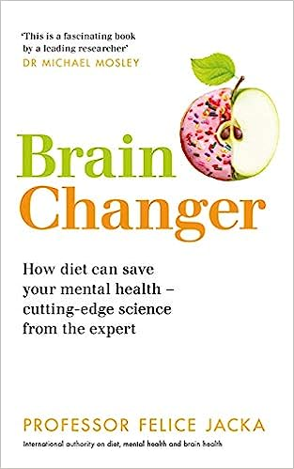
Unhealthy diets
Diet & mental health
Obesity is associated with:
Increased rates of anxiety and depression (Lavallee et al., 2021)
Increased rates of psychosocial problems and suicidal ideation among adolescents (Vuuren et al., 2019)
Depression, conduct disorder, & ADHD among children aged 10-17 (Halfon et al., 2013)
Strongest overall association (among psychiatric disorders) with depression (bi-directional relationship; Rajan & Menon, 2017; Roberts et al., 2003; Scott et al., 2008)
Discussion questions
Does obesity cause mental health problems or do mental health problems cause obesity?
Why are the two associated?
Notes:
What about diet and mental health?
A topic of increasing interest – many books published, particularly on the connection between gut health and mental health
Psychosocial problems: Psychosocial problems were assessed by the Strengths and Difficulties Questionnaire (SDQ), which is a 25-item, worldwide used screening questionnaire that asks students to report on their behaviors and emotions in the past six months. The items are distributed across five scales of five items each: emotional symptoms, conduct problems, hyperactivity/inattention, peer relationship problems and pro-social behavior.
This seems to be some suggestion in the literature that this association is stronger among females, but the evidence is inconsistent (Scott et al., 2008)
Why are the two associated?
Possible associations between obesity and mental health problems:
Physical inactivity is common among people with mental health problems
Common psychiatric medications are associated with weight gain
May both stem from common psychological factors like negative self body image
Both stem from limited access to health foods? Speculating
There may be a common cause like substance misuse or chronic pain
Listed just a few of the many studies.

Slide 15
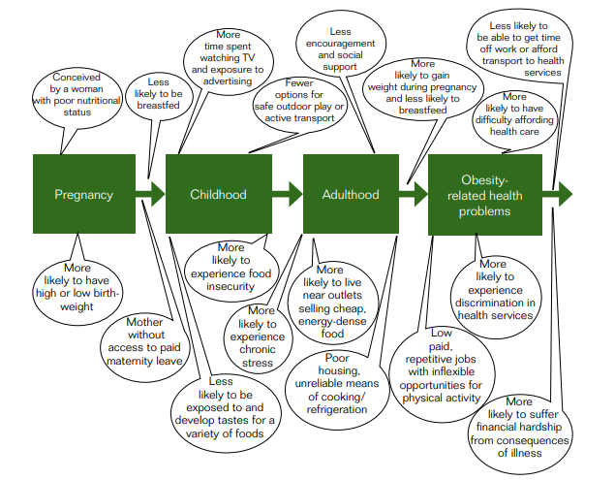
Unhealthy diets
Causes & correlates of poor dietary intake
WHO (2014): How inequalities in obesity compound over the life course
Socio-economic status
Low socio-economic status (higher disadvantage) is consistently associated with higher rates of obesity
The gap between low and high SES appears to be widening (Vincze et al., 2021)
Why?
Increased eating off large plates, eating at night, and uncontrolled eating (Pigeyre et al., 2016)
Higher intake of fat and simple carbohydrates, less fruit, vegetables, and whole wheat bread; reduced exercise facilities; decreased sense of safety (Volaco et al., 2018)
Mostly superficial explanations?
Notes:
Why do people eat poor diets????
(Pigeyre et al., 2016)
- Found that cognitive restraint and emotional eating scores were not associated with higher rates among low SES (although both were associated with obesity)
Uncontrolled eating is a tendency to eat more than usual because of a loss of control over intake
Doesn’t seem to tell the full story!
WHO IMAGE MUCH BETTER
“This policy guidance aims to support European policy-makers to improve the design, implementation and evaluation of interventions and policies to reduce inequities in overweight and obesity. The prevalence of obesity in Europe is rising in many countries, and rising fastest in low socioeconomic population groups.”

Slide 16
Unhealthy diets
Causes & correlates of poor dietary intake
External eating | Emotional eating | Internal eating | Restraint eating
Eating and catching sight of food or food related cues | Eating when bored, irritated, upset, or stressed | Eating when the body signals hunger | Chronic dieting or intentional restriction of intake to influence body weight but often punctuated with episodes of overeating
Notes:
evidence that some people have unique eating styles and that this could contribute to an increased or decreased risk of obesity, depending on style.
Essentially, restrained eaters are individuals who fail at restraining or restricting their eating.

Slide 17
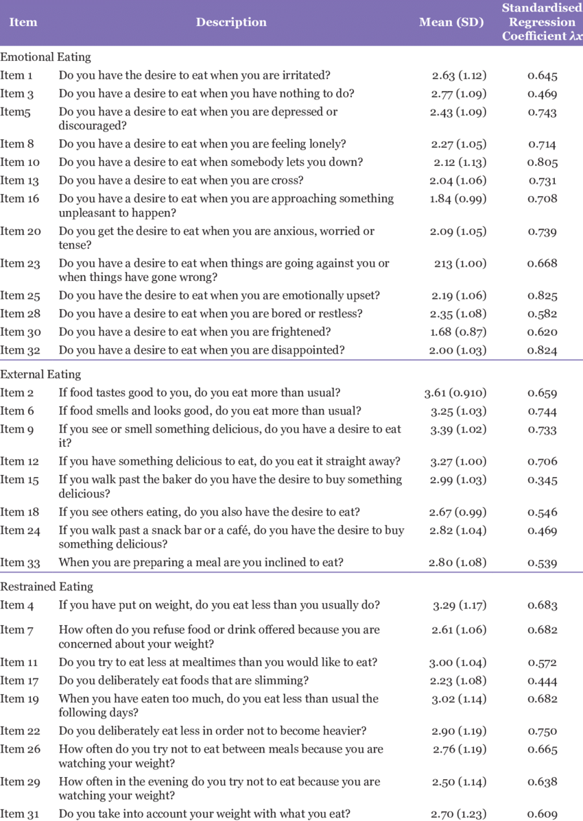
Unhealthy diets
Interactive task: What’s your eating style?
Emotional style & obesity:
Emotional eating frequently associated with increased risk of obesity (Konttinen, 2020)
Emotional eating is associated with more snacking (no external eating association) over a longer period of the day (Magklis, 2019)
Restraint eating may be an even stronger predictor of obesity (Brogan & Hevey, 2013; Adams et al., 2019)
Subramaniam et al.
(2017)
Notes:
Dutch Eating Behavior Questionnaire commonly used to assess eating styles
Emotional eating was associated with greater snacking and snacking earlier in the day and later in the day
Emotional eating is also associated with smaller meal sizes suggesting an adjustment for extra snacking
External eating doesn’t appear to be associated with anything in particular
In experimental studies, restrained eaters will consume more after eating “forbidden” (i.e., diet rule–violating) foods (for a review, see Stroebe, 2008), undergoing a negative mood induction (Cardi et al., 2015), or being exposed to threats to their self-esteem
Restrained leading a predictor or cause of obesity??? Need to find out
Eating styles are surely temporally/ contextually affected?
https://bpspsychub.onlinelibrary.wiley.com/doi/full/10.1111/bjhp.12616 – good study to add next time

Slide 18
What makes a healthy diet?
Interactive task
Please go to the following site & enter this number:
13 59 11 8
What makes a healthy diet?
What do you think?
Login to Menti and add your suggestions
Class discussion
https://www.menti.com/
Notes:
Covered unhealthy, now let’s think about what it means to eat healthily?

Slide 19
Block 2 How can we promote healthy eating behaviour?

Slide 20
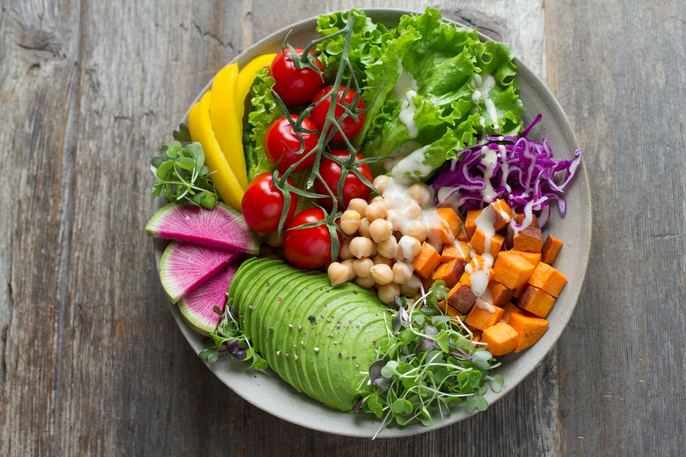
How can we promote healthy eating behaviour?
Key strategies
General requirements of an effective intervention to improve dietary behaviour:
Need to first understand the factors associated with the development of obesity (Morrison et al., 2019)
Act early (Simmonds et al., 2016)
Tailored to the “group” or population targeted
Based on theories/models of health behaviour (Rigby et al., 2020)
Notes:
Act early:
Obese children and adolescents were around five times more likely to be obese in adulthood than those who were not obese. Around 55% of obese children go on to be obese in adolescence, around 80% of obese adolescents will still be obese in adulthood and around 70% will be obese over age 30.

Slide 21
How can we promote healthy eating behaviour?
Behaviour change models
Theory of Planned Behaviour (TPB)
Outcome expectancies X outcome value
Attitudes
Demographic variables (e.g., age, sex, race), personality, & past experience
Normative belief X motivation to comply
Subjective norm
Behavioural intention
Behaviour
Perceived internal & external control factors
Perceived behavioural
control
21
Notes:
TBM is commonly used these days and suggests people act in a goal directed manner in which the implications of their actions are weighed up in a “reasoned” manner, but not necessarily a rational one.
Proposes that attitudes, subjective norms, and perceived behavioural control all directly impact our intention to perform a behaviour, and it is this intention that is the proximal determinant of behaviour:
Attitudes: made up of outcome expectancy beliefs and outcome value
Outcome expectancy beliefs: what will the outcome be of performing this behaviour (exercising will increase my health)
Outcome value: how valuable is the outcome from the behaviour to me? (I value being healthy)
Subjective norms: comprised of motivation to comply and normative beliefs
Normative beliefs: what is perceived to be common and normal behaviour among one’s social sphere in specific settings
Motivation to comply: the extent to which they wish to comply or fall into line with the preferences or norms of others (I want my friends to like me)
PBC: a person’s belief that they have control over their own behaviour in certain situations
It is similar to self-efficacy, although SE refers to how how easy or difficult someone thinks the behaviour will be for them, whereas PBC refers to whether someone feels they actually have control over the behaviour.
Internal control – Self efficacy
External control – PBC
Some now include this distinction or SE in TPB models
The theory of reasoned action did not include PBC

Slide 22
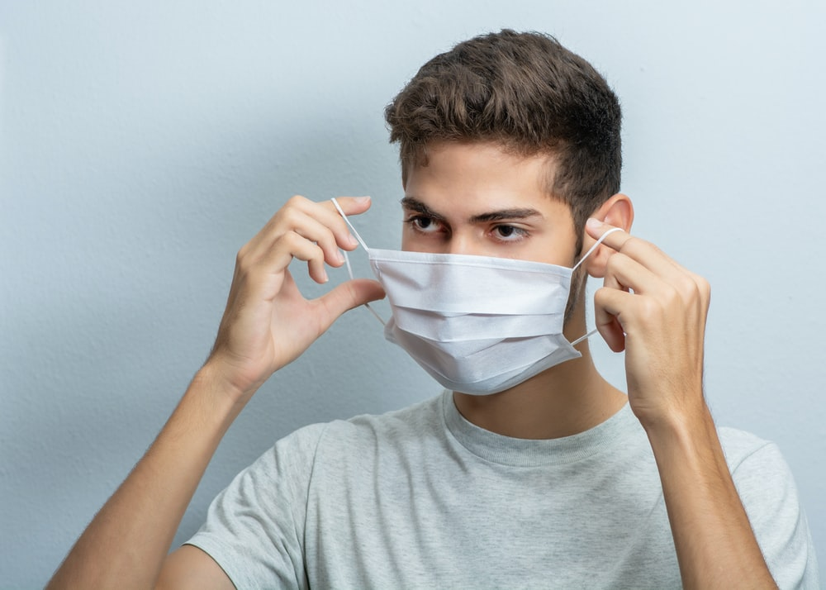
How can we promote healthy eating behaviour?
Behaviour change models
Theory of Planned Behaviour (TPB)
Limitations:
The intention-behaviour gap
Fails to consider many influences on behaviour:
Past experience (Heirene & Gainsbury, 2021)
Habits
Moral norms
Anticipatory regret
Self-identity
Social support
Planning
Benefits & uses:
Generally, a good predictor of engaging with health protective behaviours (Armitage, 2005; Gao et al., 2021; Menozzi et al., 2015; 2017)
Strong predictor of covid-19 protective behaviour Wollast et al., 2021)
Accounts for social influences on behaviour
22
Notes:
Rob: ADD ANOTHER COVID-19 study – there are loads!
Benefits
- Good predictor of healthy eating and exercise behaviour
Parsimonious approach for understanding complex f human behavior and offers a simple structure between behaviors and their antecedents
More variables we include the more predictive, potentially, but that comes at the expense of complexity and making it more difficult to interpret for lay-persons and non-psychologists interested in behavior change.
Limitations
The intention-behaviour gap: changes in intention don’t always necessarily manifest in changes in behaviour
What moves people from intention to action?
Past experience: often the best predictors of what we will do in the future is what we’ve done in the past (make reference to messaging trial and history those who responded)
Habits: Doesn’t account for habits and automatic behaviour which are strong predictors but may not be accounted for by variation in TPB factors
Moral intentions: some intentions and behaviour may be partially motivated by moral norms, rather than social norms, including drunk driving. COVID link here!
Anticipatory regret: feels the fully account for the emotional influence on behaviour. Anticipatory regret refers to the potential regret faced by not engaging in a behaviour (e.g., I would really regret it if I didn’t wear a condom and she got pregnant)
Self-identity: Who you identify is a very strong predictor of behaviour (e.g., Vegetarian, fitness enthusiast, strongly politically left-leaning)
Social support: social support can be both persuasive and encouraging versus critical in undermining and can have substantial impact on the attempts to change behaviour
Planning: Sometimes our behaviour is premeditated and planned over an extended period of time and these plans may not marry with TPB components

Slide 23
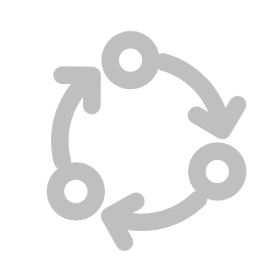
How can we promote healthy eating behaviour?
Behaviour change models
Precontemplation
No intention of changing behaviour
The Transtheoretical Model (TTM)
Relapse
Fall back into earlier behaviour patters
Contemplation
Awareness of problem but not committed to action
Progress through the stages is mediated by decisional balance (e.g., costs versus benefits of the behaviour changes benefits of the behaviour change) and self-efficacy.
Termination
Extended maintenance & total confidence in maintaining behaviour
Maintenance
Behaviour is maintained but vulnerable to relapse
Preparation
Ready to change & setting goals
Action
Overt behaviour change
23
Notes:
Models of behaviour change now
TTM: Also referred to as the “Stages of Change” model
This theory was originally developed to explain smoking cessation but has since been applied to a variety of behaviours
Assumes people are always in one discrete stage in relation to particular behaviours
People move through the stages sequentially but…
Can start at pre-contemplation and move to action, then jump back down to contemplation and back up to action. Progress can halt and reverse
Precontemplation: individuals may be in denial about the health issue or not realise they have one and has no intention to change their behaviour in the next six months
Contemplation: generally assessed as a desire to change within the next six months. People may start to seek information about potential behaviour change, although they may still underestimate the vulnerability to the health threat
Preparation: people start to set goals and priorities and make plans. Perhaps they will advertise this to family or friends, and start to move towards behaviour change. Usually within three months of action
Action: realistic goal setting is important here and social support can help to maintain the lifestyle change
Maintenance: bheaivour is maintained for more than 6 months. Many individuals will not succeed in maintaining behavioural change (depending on the setting – e.g., exercise vs addiction recovery) and will recycle or relapse back to contemplating the future attempt to change.
Decisional balance: a form of outcome expectancy in which the pros of engaging with the behaviour are weighed against the cons.
An individual on the contemplation stage is likely to focus on both the pros and cons of change, but the cons may be more heavily weighted at this time
Individuals at the preparation and action stage may be more focused on the pros of change.
Self-efficacy increases as the person moves through each stage (see: https://www.ncbi.nlm.nih.gov/core/lw/2.0/html/tileshop_pmc/tileshop_pmc_inline.html?title=Click%20on%20image%20to%20zoom&p=PMC3&id=2990961_nihms199522f1.jpg)

Slide 24
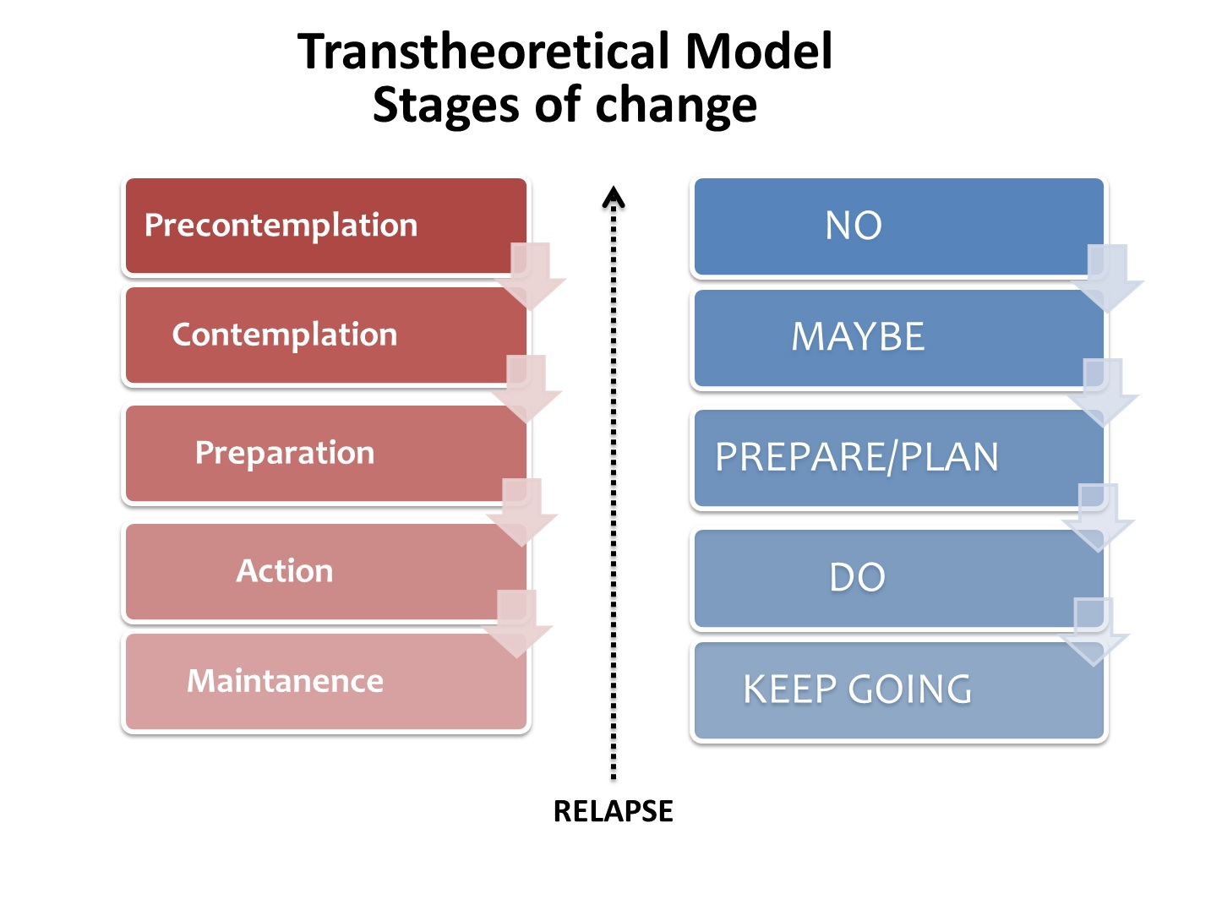
How can we promote healthy eating behaviour?
Behaviour change models
The Transtheoretical Model (TTM)
Limitations:
Doesn’t fully consider:
Past behaviour
Social influences
Value of the five independent stages is questionable
How long does each last?
Assumes (questionable) rational decision making process (i.e., decisional balance)
Benefits & uses:
Provides a framework for considering behaviour change & readiness to change
Recognition that different people are at different stages
Allows clinicians and researchers to make recommendations for people at each stage (Nig et al., 2011)
24
Notes:
Benefits
- Good
Limitations
The value of the five independent stages is questionable, and some studies fail to be able to allocate people to each of the stages
It’s been suggested that a continuous variable of readiness may be more useful than discrete stages
The theory ignores the social context in which change occurs, such as SES and income.
The lines between the stages can be arbitrary with no set criteria of how to determine a person's stage of change. The questionnaires that have been developed to assign a person to a stage of change are not always standardized or validated.
There is no clear sense for how much time is needed for each stage, or how long a person can remain in a stage.
Assumes a rational decision-making process: The TTM holds that people begin to perceive more benefits than disadvantages from adopting positive behavior changes as they move through the later stages

Slide 25
How can we promote healthy eating behaviour?
Behaviour change models
Social Cognitive Theory (Bandura, 1986; 2008)
Basing dietary interventions on behaviour change theories (e.g., TPB, TTM/SoC)
Randomised controlled trials of dietary behaviour change using behaviour change models are more effective (Michie et al., 2009; Rigby et al., 2020)
Most behaviour change interventions appear to use Social Cognitive Theory (Matenga-Ikihele et al., 2021; Rigby et al., 2020)
Personal factors
The behaviour
Environmental factors
Discussion question
Why might using behavioural change models improved intervention effectiveness?
Notes:
Health belief model
Theory of planned behaviour
Transtheoretical model/stages of change
There are three major constructs in SCT that interact to influence behavior:
personal factors (age, cognitions, previous experience with the behavior, etc.),
environmental factors (access to resources, safety, support from family/friends, etc.),
aspects of the behavior itself (vigor of the behavior, outcomes achieved as a result of practicing the behavior, competence with the behavior, etc.).
Successful efforts to change behavior depend on identification of the positive supports and the detractors in each of the three constructs.
Also highlight important of self-efficacy and vicarious learning. Much more complex than described here
https://www.sciencedirect.com/topics/medicine-and-dentistry/social-cognitive-theory
For example, if a therapist is managing the physical or occupational therapy services of a patient who has multiple sclerosis and this patient is motivated to be physically active yet does not have a safe place to walk or be physically active near home, the patient will likely not be able to consistently perform physical activity. If the same patient works for an employer who provides an onsite gym, the patient could negotiate with her supervisor to utilize the gym to be physically active a few days a week.
Why? Potentially increases focus on the factors causing people to engage in the behaviour or preventing them from doing so – self-efficacy, social support etc.

Slide 26
How can we promote healthy eating behaviour?
Common types of intervention
Common interventions used to tackle poor diets & obesity (Walls et al., 2011)
Community-based interventions
Building sport, exercise, and play facilities; hiring sports instructors; adapting environment to encourage exercise behaviours (e.g., cycle paths); offering cooking classes changing school menus; encouraging active play among children
(See also Haby et al., 2012)
Social marketing campaigns
Media campaigns that emphasise the importance of healthy eating and physical activity; media campaigns that emphasise the desirability of achieving a healthy body weight; social modelling as a behaviour change strategy
(See also Evans et al., 2012)
Drug therapies
There are a small number approved anti-obesity drugs available.
Most have shown limited efficacy and considerable adverse effects (many have been withdrawn from prescription /sale)
(See also Cheung et al., 2013)
Surgery
Bariatric surgeries include gastric bypasses and sleeve gastrectomy
Typically only used in cases where: BMI > 40, diet and exercise have failed, obesity–related comorbidities are present (diabetes, sleep apnoea)
(See also Glandt & Raz, 2011)
Notes:
Community-based interventions (Haby et al., 2012):
Potential limitations are that its impact can be limited to a small number of people within a small community;
Effective community-based interventions require significant penetration or exposure within the community that is, the proportion of community members who take part in the intervention must be sufficient
as opposed to regulatory changes which may have broader impact (e.g., sugar tax; minimum unit alcohol sales et cetera) DISCUSS MOSTLY ON NEXT SLIDE
Social marketing campaigns tend to be more effective among children, who are more easily encouraged to change their behaviour (Evans et al., 20212).
Limited success of such programs, particular over the long term (Walls et al., 2011)
Social marketing campaigns focused on weight loss explicitly tend to be particularly poor at achieving their outcomes (Walls et al., 2011)
There is concern that both community-based and social marketing campaigns placed too much emphasis on individual behaviour (although, the former to a lesser/ more inconsistent extent)
- They overly focus on the social desirability of thinness which might be perceived negatively by some and increased the stigma associated with obesity.
- Walls et al. argue that there is a need to decrease focus on the undesirable features of obesity and increased focus on the benefits of healthy diet and exercise
Drug therapies
Some of the dose can only be used for 12 weeks because the long-term safety effects of the drugs is unknown! (Cheung et al., 2013)
Interestingly, from my initial searches it doesn’t appear like there’s been much new research in this area over the last 10 years. Although that could be incorrect.
Surgery
Sleeve gastrectomy, procedure is typically performed laparoscopically–about 80% of the stomach is removed, leaving a tube-shaped stomach about the size and shape of a banana.
Gastric bypass: a type of weight-loss surgery that involves creating a small pouch from the stomach and connecting the newly created pouch directly to the small intestine. After gastric bypass, swallowed food will go into this small pouch of stomach and then directly into the small intestine, thereby bypassing most of your stomach and the first section of your small intestine.
Also limited to the people that can access and afford this type of surgery!

Slide 27
How can we promote healthy eating behaviour?
The need for regulatory change
Ways forward (Walls et al., 2011) with obesity campaigns:
Strategies reliant on individual behaviour change are unlikely to be effective
The “individual choice” approach is insufficient
Society-wide changes that facilitate dietary behaviour change are needed
Regulation in other areas of public health has proved extremely effective (e.g., seat belts, smoking, vaccinations)
Regulatory approaches reduce inequalities in obesity
Frieden et al.’s (2017) three-pronged strategy
Food pricing adjustments (subsidies on fruits and vegetables and taxation is applied to energy-dense and nutrient-poor foods)
Increasing exposure to healthy food and decreasing exposure to unhealthy food (display and location restrictions)
Improving the image of healthy food and making unhealthy food less attractive ( restrictions on advertising and presentation of foods)
Notes:
Social marketing campaigns are more likely to be heeded by those with already high levels of education and people with low educational attainment are much less likely to change their behaviour as a result of education efforts; hence the need for legislative change
More likely to affect the whole population

Slide 28
How can we promote healthy eating behaviour? Interactive task
Please go to the following site & enter this number:
13 59 11 8
Should we have a sugar tax in the UK that extends beyond soft drinks?
Why or why not?
What do you think?
Do some research: What does the evidence say?
Login to Menti and add your findings and suggestions
Class discussion
https://www.menti.com/
Notes:
Could use this as an activity next year: https://www.ncbi.nlm.nih.gov/books/NBK64942/table/A61041/
Get them to fill out what types of interventions might be useful at each stage!

Slide 29
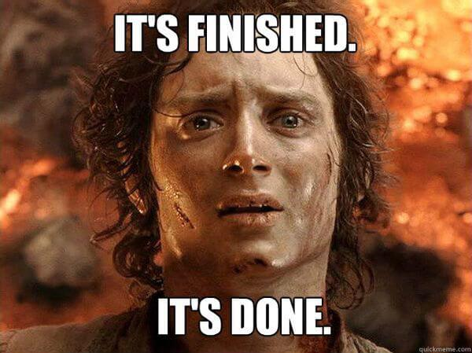
Next week: Easter break

Slide 30
Credits & Sources
If an image in this slideshow does not have a link to the source posted below it, then I have either taken the picture myself or taken it from the site www.unsplash.com and clicking the image will take you to the original source on unsplash.

Slide 31
References
Abarca-Gómez, L., Abdeen, Z. A., Hamid, Z. A., Abu-Rmeileh, N. M., Acosta-Cazares, B., Acuin, C., Adams, R. J., Aekplakorn, W., Afsana, K., Aguilar-Salinas, C. A., Agyemang, C., Ahmadvand, A., Ahrens, W., Ajlouni, K., Akhtaeva, N., Al-Hazzaa, H. M., Al-Othman, A. R., Al-Raddadi, R., Buhairan, F. A., … Ezzati, M. (2017). Worldwide trends in body-mass index, underweight, overweight, and obesity from 1975 to 2016: a pooled analysis of 2416 population-based measurement sBIBAN, B. & LICHIARDOPOL, C. (2017). Iodine Deficiency, Still a Global Problem? Current Health Sciences Journal, 43(2), 103–111. https://doi.org/10.12865/chsj.43.02.01tudies in 128·9 million children, adolescents, and adults. The Lancet, 390(10113), 2627–2642. https://doi.org/10.1016/s0140-6736(17)32129-3
Adams, R. C., Chambers, C. D. & Lawrence, N. S. (2019). Do restrained eaters show increased BMI, food craving and disinhibited eating? A comparison of the Restraint Scale and the Restrained Eating scale of the Dutch Eating Behaviour Questionnaire. Royal Society Open Science, 6(6), 190174. https://doi.org/10.1098/rsos.190174
Australian Institute of Health and Welfare (2021) Australian Burden of Disease Study 2018: Interactive data on risk factor burden, AIHW, Australian Government. https://www.aihw.gov.au/reports/burden-of-disease/abds-2018-interactive-data-risk-factors/contents/about
Bandura, A. (1986). Social foundations of thought and action: A social cognitive theory. Englewood Cliffs, NJ: Prentice Hall.
Bandura, A. (2008). Social Cognitive Theory. The International Encyclopedia of Communication. https://doi.org/10.1002/9781405186407.wbiecs053

Slide 32
References
Cheung, B. M. Y., Cheung, T. T. & Samaranayake, N. R. (2013). Safety of antiobesity drugs. Therapeutic Advances in Drug Safety, 4(4), 171–181. https://doi.org/10.1177/2042098613489721
Brogan, A. & Hevey, D. (2013). Eating styles in the morbidly obese: Restraint eating, but not emotional and external eating, predicts dietary behaviour. Psychology & Health, 28(6), 714–725. https://doi.org/10.1080/08870446.2012.760033
Evans, W. D., Christoffel, K. K., Necheles, J. W. & Becker, A. B. (2010). Social Marketing as a Childhood Obesity Prevention Strategy. Obesity, 18(S1), S23–S26. https://doi.org/10.1038/oby.2009.428
Frieden, T. R., Dietz, W. & Collins, J. (2017). Reducing Childhood Obesity Through Policy Change: Acting Now To Prevent Obesity. Health Affairs, 29(3), 357–363. https://doi.org/10.1377/hlthaff.2010.0039
Glandt, M. & Raz, I. (2011). Present and Future: Pharmacologic Treatment of Obesity. Journal of Obesity, 2011, 636181. https://doi.org/10.1155/2011/636181
Haby, M. M., Doherty, R., Welch, N. & Mason, V. (2012). Community-based interventions for obesity prevention: lessons learned by Australian policy-makers. BMC Research Notes, 5(1), 20–20. https://doi.org/10.1186/1756-0500-5-20
Hudson S. Healthy stores, healthy communities: the impact of outback stores on remote indigenous Australians. St Leonards: Centre for Independent Studies; 2010
Konttinen, H. (2020). Emotional eating and obesity in adults: the role of depression, sleep and genes. Proceedings of the Nutrition Society, 79(3), 283–289. https://doi.org/10.1017/s0029665120000166

Slide 33
References
Kreuter, M. W., Lukwago, S. N., Bucholtz, D. C., Clark, E. M. & Sanders-Thompson, V. (2003). Achieving Cultural Appropriateness in Health Promotion Programs: Targeted and Tailored Approaches. Health Education & Behavior, 30(2), 133–146. https://doi.org/10.1177/1090198102251021
Lavallee, K. L., Zhang, X. C., Schneider, S. & Margraf, J. (2021). Obesity and Mental Health: A Longitudinal, Cross-Cultural Examination in Germany and China. Frontiers in Psychology, 12, 712567. https://doi.org/10.3389/fpsyg.2021.712567
Magklis, E., Howe, L. D. & Johnson, L. (2019). Eating Style and the Frequency, Size and Timing of Eating Occasions: A cross-sectional analysis using 7-day weighed dietary records. Scientific Reports, 9(1), 15133. https://doi.org/10.1038/s41598-019-51534-w
Matenga-Ikihele, A., McCool, J., Dobson, R., Fa’alau, F. & Whittaker, R. (2021). The characteristics of behaviour change interventions used among Pacific people: a systematic search and narrative synthesis. BMC Public Health, 21(1), 435. https://doi.org/10.1186/s12889-021-10420-9
Michie, S., Abraham, C., Whittington, C., McAteer, J. & Gupta, S. (2009). Effective Techniques in Healthy Eating and Physical Activity Interventions: A Meta-Regression. Health Psychology, 28(6), 690–701. https://doi.org/10.1037/a0016136

Slide 34
References
Pigeyre, M., Rousseaux, J., Trouiller, P., Dumont, J., Goumidi, L., Bonte, D., Dumont, M.-P., Chmielewski, A., Duhamel, A., Amouyel, P., Dallongeville, J., Romon, M. & Meirhaeghe, A. (2016). How obesity relates to socio-economic status: identification of eating behavior mediators. International Journal of Obesity, 40(11), 1794–1801. https://doi.org/10.1038/ijo.2016.109
Rajan, T. & Menon, V. (2017). Psychiatric disorders and obesity: A review of association studies. Journal of Postgraduate Medicine, 63(3), 182–190. https://doi.org/10.4103/jpgm.jpgm_712_16
Resnicow, K., Baranowski, T., Ahluwalia, J. S. & Braithwaite, R. L. (1999). Cultural sensitivity in public health: defined and demystified. Ethnicity & Disease, 9(1), 10–21.
Rigby, R. R., Mitchell, L. J., Hamilton, K. & Williams, L. T. (2020). The Use of Behavior Change Theories in Dietetics Practice in Primary Health Care: A Systematic Review of Randomized Controlled Trials. Journal of the Academy of Nutrition and Dietetics, 120(7), 1172–1197. https://doi.org/10.1016/j.jand.2020.03.019
Roberts, R. E., Deleger, S., Strawbridge, W. J. & Kaplan, G. A. (2003). Prospective association between obesity and depression: evidence from the Alameda County Study. International Journal of Obesity, 27(4), 514–521. https://doi.org/10.1038/sj.ijo.0802204
Roser, M., & Ritchie, H. (2017) - "Micronutrient Deficiency". Published online at OurWorldInData.org. Retrieved from: 'https://ourworldindata.org/micronutrient-deficiency' [Online Resource]
Roser, M., & Ritchie, H. (2019). "Hunger and Undernourishment". Published online at OurWorldInData.org. Retrieved from: 'https://ourworldindata.org/hunger-and-undernourishment' [Online Resource]

Slide 35
References
Scott, K. M., Bruffaerts, R., Simon, G. E., Alonso, J., Angermeyer, M., Girolamo, G. de, Demyttenaere, K., Gasquet, I., Haro, J. M., Karam, E., Kessler, R. C., Levinson, D., Mora, M. E. M., Browne, M. A. O., Ormel, J., Villa, J. P., Uda, H. & Korff, M. V. (2008). Obesity and mental disorders in the general population: results from the world mental health surveys. International Journal of Obesity, 32(1), 192–200. https://doi.org/10.1038/sj.ijo.0803701
Simmonds, M., Llewellyn, A., Owen, C. G. & Woolacott, N. (2016). Predicting adult obesity from childhood obesity: a systematic review and meta-analysis. Obesity Reviews, 17(2), 95–107. https://doi.org/10.1111/obr.12334
Stevens, G. A., Bennett, J. E., Hennocq, Q., Lu, Y., De-Regil, L. M., Rogers, L., Danaei, G., Li, G., White, R. A., Flaxman, S. R., Oehrle, S.-P., Finucane, M. M., Guerrero, R., Bhutta, Z. A., Then-Paulino, A., Fawzi, W., Black, R. E. & Ezzati, M. (2015). Trends and mortality effects of vitamin A deficiency in children in 138 low-income and middle-income countries between 1991 and 2013: a pooled analysis of population-based surveys. The Lancet Global Health, 3(9), e528–e536. https://doi.org/10.1016/s2214-109x(15)00039-x
Subramaniam, K., Low, W. Y., Chinna, K., Chin, K. F. & Krishnaswamy, S. (2017). Psychometric Properties of the Malay Version of the Dutch Eating Behaviour Questionnaire (DEBQ) in a Sample of Malaysian Adults Attending a Health Care Facility. Malaysian Journal of Medical Sciences, 24(4), 64–73. https://doi.org/10.21315/mjms2017.24.4.8
Vincze, L., Barnes, K., Somerville, M., Littlewood, R., Atkins, H., Rogany, A. & Williams, L. T. (2021). Cultural adaptation of health interventions including a nutrition component in Indigenous peoples: a systematic scoping review. International Journal for Equity in Health, 20(1), 125. https://doi.org/10.1186/s12939-021-01462-x

Slide 36
References
Volaco, A., Cavalcanti, A. M., Filho, R. P. & Precoma, D. B. (2018). Socioeconomic Status: The Missing Link Between Obesity and Diabetes Mellitus? Current Diabetes Reviews, 14(4), 321–326. https://doi.org/10.2174/1573399813666170621123227
Vuuren, C. L. van, Wachter, G. G., Veenstra, R., Rijnhart, J. J. M., Wal, M. F. van der, Chinapaw, M. J. M. & Busch, V. (2019). Associations between overweight and mental health problems among adolescents, and the mediating role of victimization. BMC Public Health, 19(1), 612. https://doi.org/10.1186/s12889-019-6832-z
Walls, H. L., Peeters, A., Proietto, J. & McNeil, J. J. (2011). Public health campaigns and obesity - a critique. BMC Public Health, 11(1), 136. https://doi.org/10.1186/1471-2458-11-136
Wessells, K. R. & Brown, K. H. (2012). Estimating the Global Prevalence of Zinc Deficiency: Results Based on Zinc Availability in National Food Supplies and the Prevalence of Stunting. PLoS ONE, 7(11), e50568. https://doi.org/10.1371/journal.pone.0050568
World Health Organisation (WHO). ( 2014). Obesity and in equities. Guidance for addressing inequities in overweight and obesity. https://www.euro.who.int/__data/assets/pdf_file/0003/247638/obesity-090514.pdf

